Slide 1
L7 MPU Presentation 2020

Slide 2
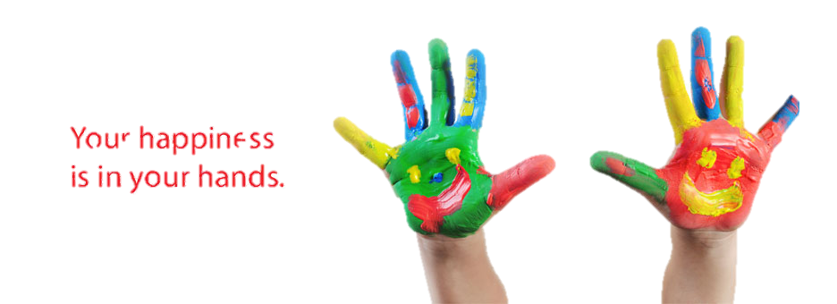
1 Yumira
The level 7 class presentation is on Covid -19 Buddhism and the future…
On how we can use the Buddha’s teachings to cope with the dramatic changes to our way of life, using the teachings in the Maha Mangala and Karaniya Metta Suttas as strategies in facing the future
Your happiness is in your hands

Slide 3
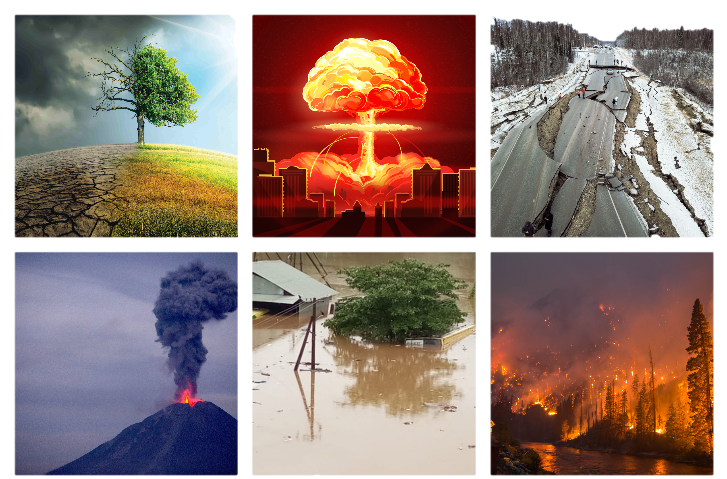
2 Hasala
Climate change! Earthquakes! volcanic eruptions! Floods! Fire! Extreme drought! Man made disasters!
These have become increasingly frequent. And now, a worldwide pandemic!
The future looks grim. How do we live without being anxious and fearful?

Slide 4
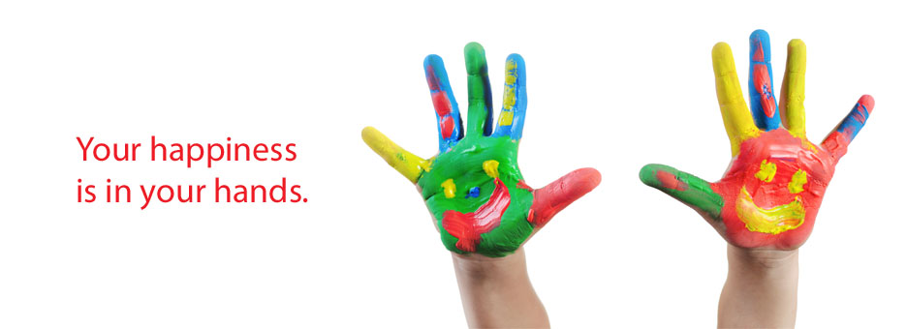
3 Amisha
COVID-19 had had a powerful impact on the world, on people’s social relationships, their families and their day to day lives.
The Buddha showed us that happiness and peace come from the inside not from without, and that we alone have the power to make us happy, and he gave us tools that would ensure our prosperity and happiness regardless of our situation and the external conditions. Some of these tools (his teachings) are within the Karaniya Metta Sutta and the Maha Mangala Sutta and are very relevant to recent troubles within the world including COVID-19.

Slide 5
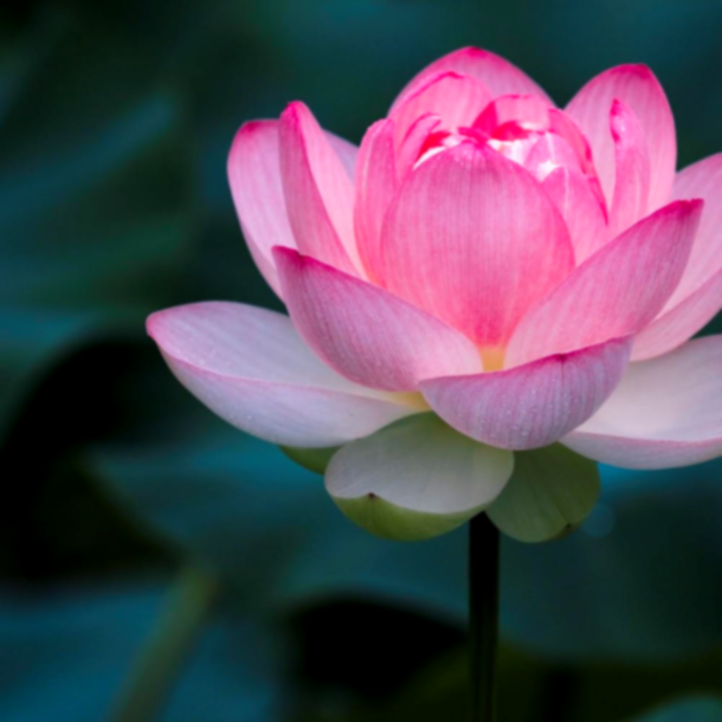
4 Minsandee
Mangala means fortunate or lucky, leading to happiness and prosperity.
The first mangala we reflect on is pubbeca kata punnyata to know we have done good in the past.
We have been born human and we enjoy great comfort. Our basic needs of food. Shelter, clothing, and medicine are well met. It did not happen by chance or luck, but because we have good karma. We have done good in past lives. We must always keep it in mind and make every effort to abstain from and avoid deeds that will have unpleasant vipaka in the future

Slide 6
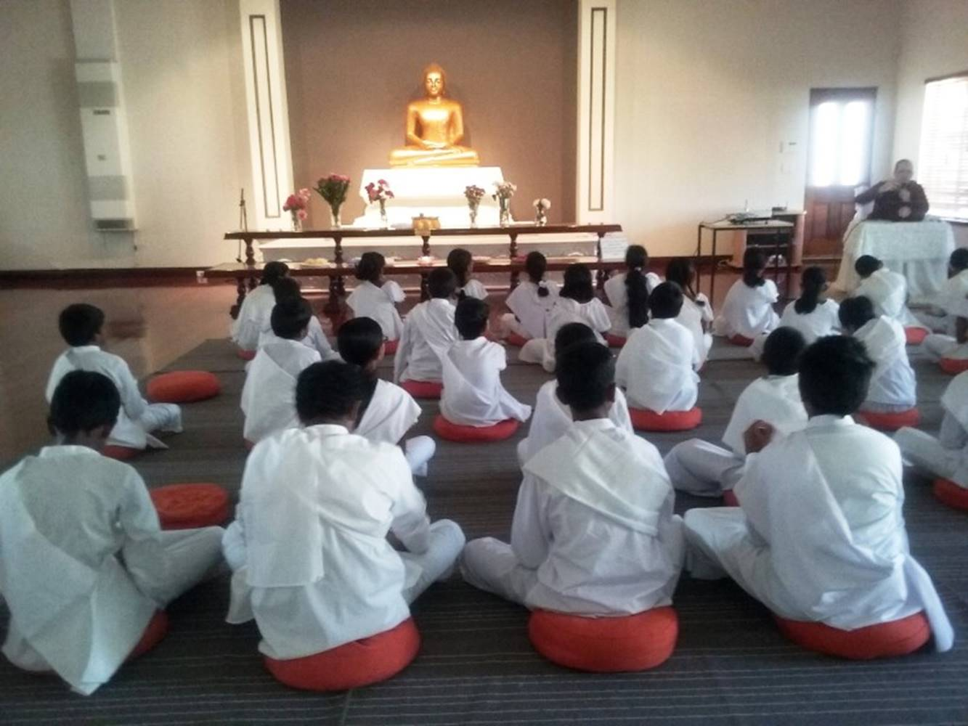
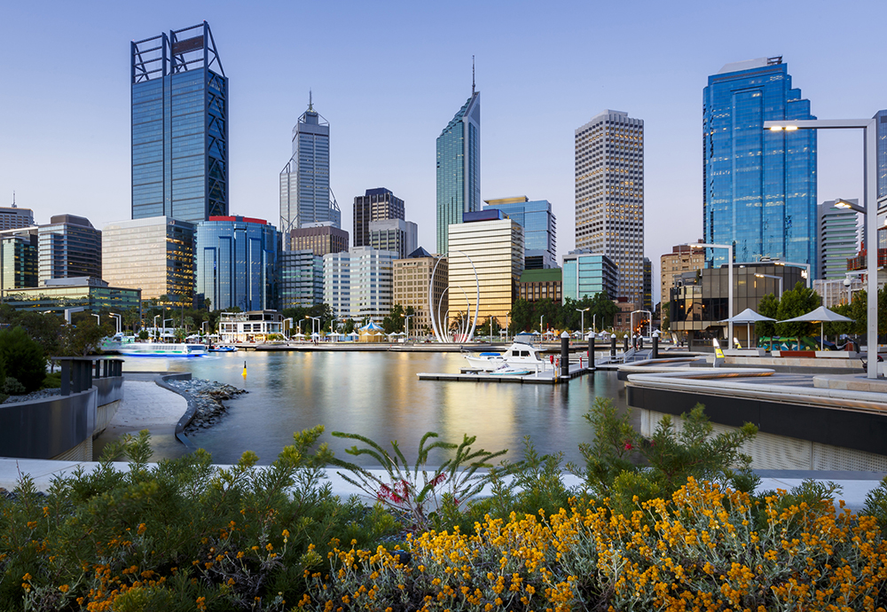
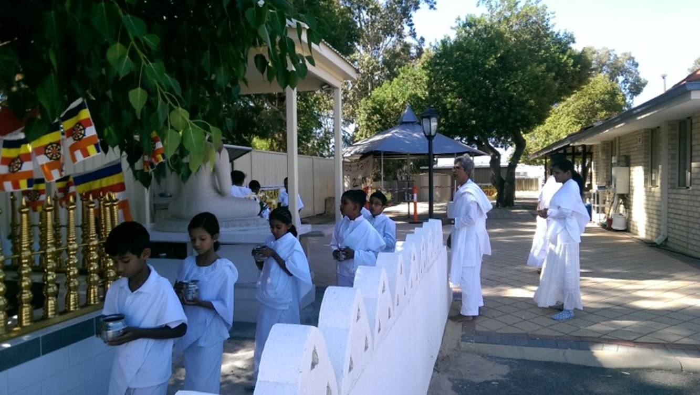
5 Ravindu
Patirupadesa vasoca
We live in a suitable locality – We are blessed to live in Western Australia. We have not been affected by Covid 19. We can go about our daily lives in safety. We have not had shortages of food or medical supplies. We have been able to visit temples and monasteries and practise Dhamma

Slide 7
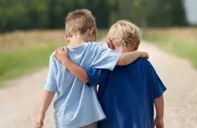
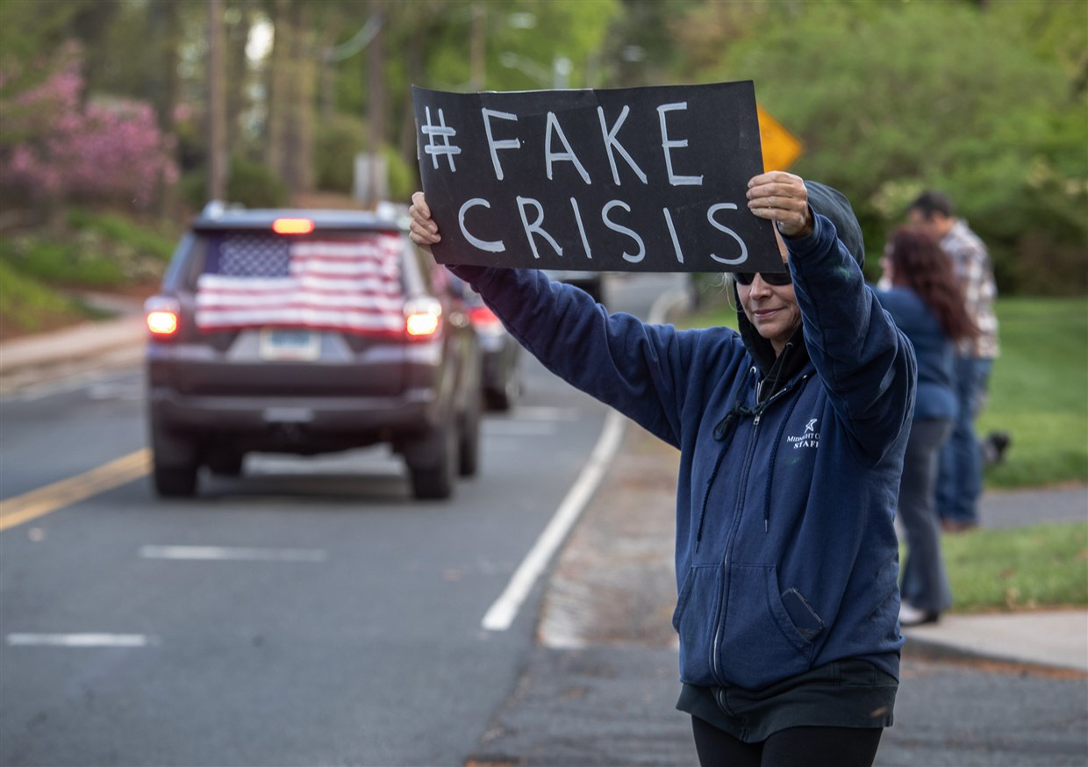
6 Binthi
Asevanaca balanam panditananca sevana
At a time like this, good friends – Friends who observe rules and live in accordance with the 5 precepts are more important than ever. Associating with people who encourage others to break rules is dangerous. The virus has spread in many places because of foolish friends who did just that

Slide 8
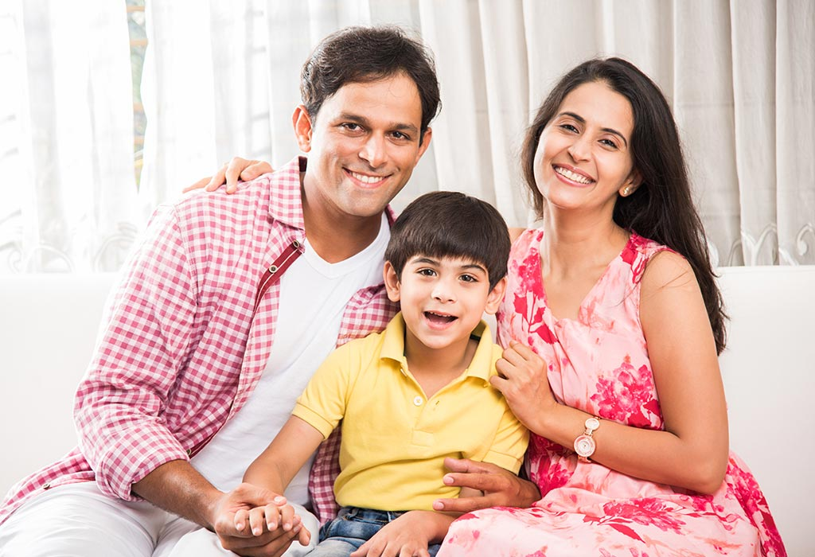
6 Binthi
Mata pitu upatthanam … Nyatakanamca sangaho … pujaca pujaniyanam
This is a time for families to support and look after each other. To be respectful and listen to parents and elders and heed their advice.

Slide 9
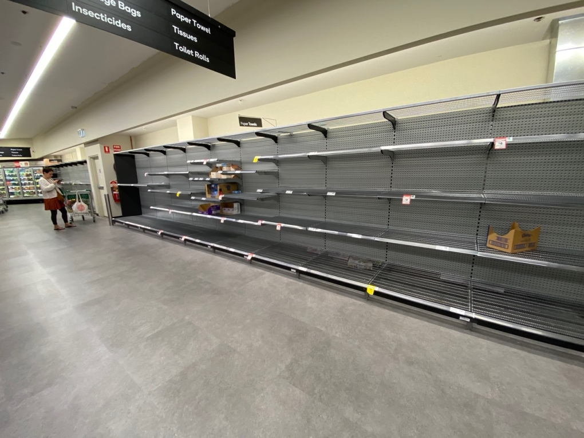
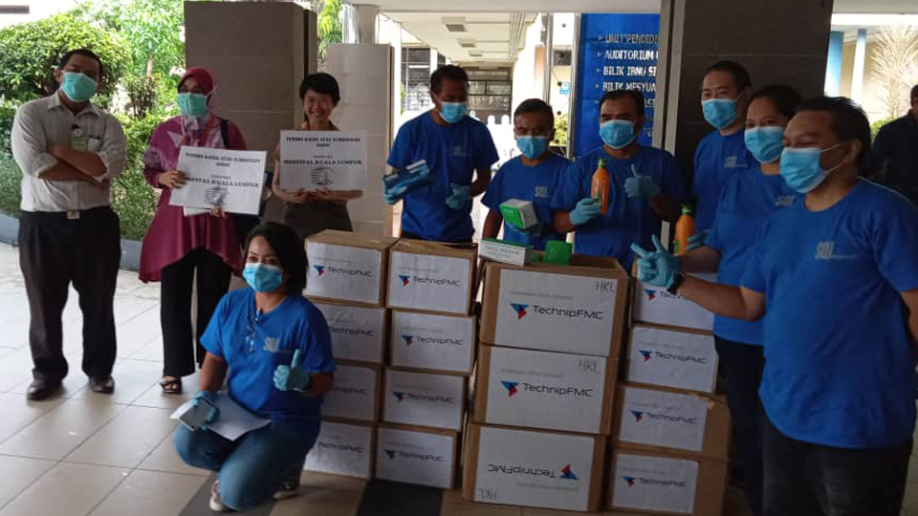
7. Hasiru
Dananca
While looking after ourselves, caring for others, being generous and sharing what we have leads to happiness and harmony in a community. In the early days of the pandemic artificial shortages were created by hoarders leading to panic buying in whole communities and causing unnecessary suffering.

Slide 10
8 Pabawath
Bahu saccanca sippanca
We realise at times like this how important it is to study hard and develop skills that will help us gain employment in the future, so that we can continue to live in comfort.

Slide 11
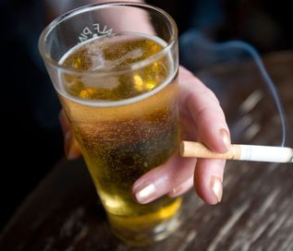
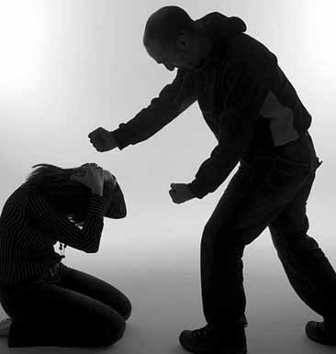
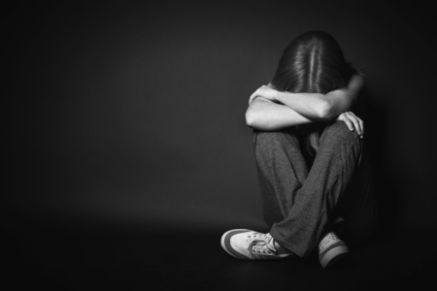
8 Pabawath
Subhasitaca ya vaca – kantica sovacassata
Confined living during periods of lockdown have seen violence and abuse in families. Practicing good speech, we do not get into arguments that can lead to violence. We must be patient, kind and respectful.
Majjapanaca sanjamo
Not keeping the 5th precept has caused a great deal of suffering in many families and not just during the pandemic.

Slide 12
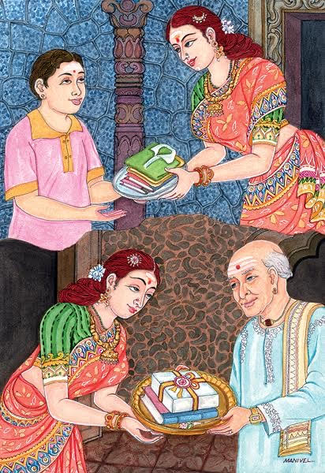
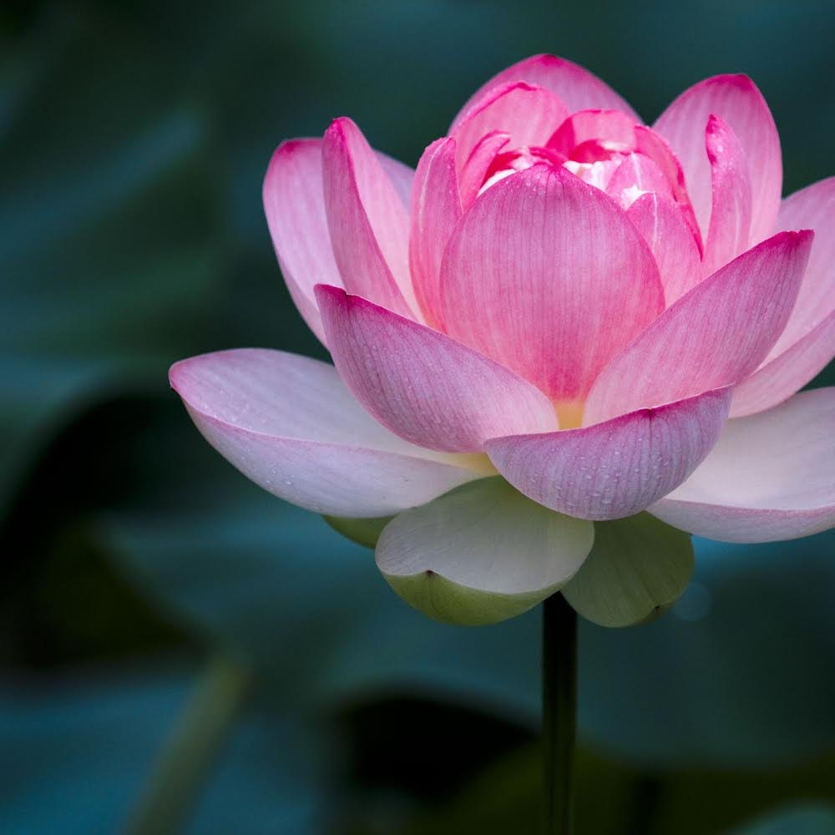
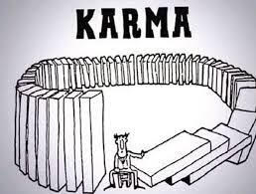
9 Okithma
Arati virati papa …. Atta samma panidica …. Appamadoca dhammesu …
As Buddhists we believe in the laws of karma. That bad actions lead to bad results and good actions lead to good results.
When we set ourselves on the right course, living according to the Dhamma, when we abstain from and refrain from wrongdoing, when our words, deeds and even thoughts are blameless we have nothing to fear. Our good actions now, can only bring us peace and happiness in the future.

Slide 13
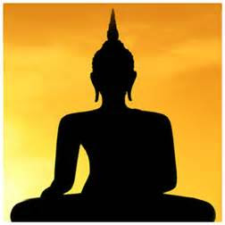
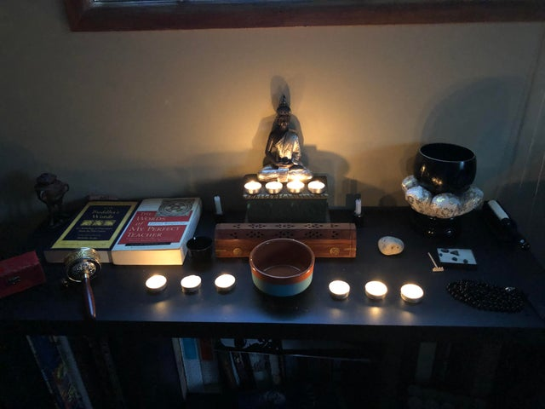
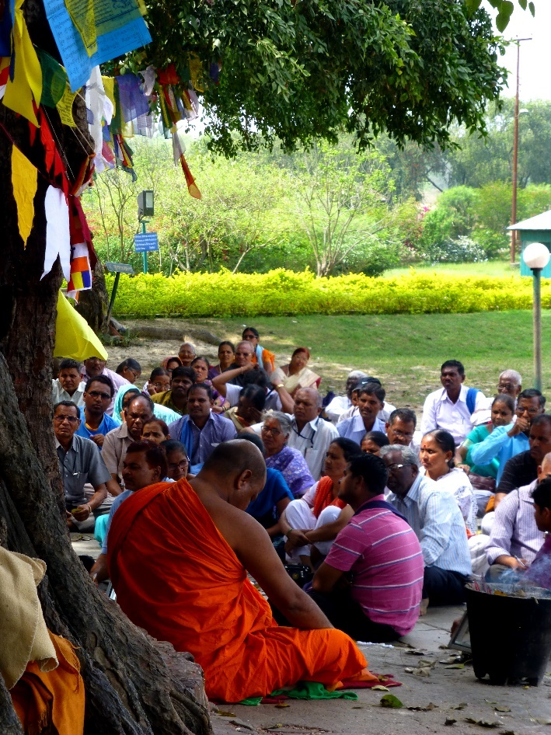
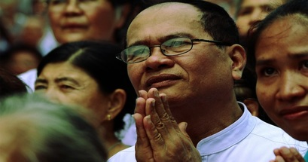
10 Chanumi
kalena dhamma savanam kalena dhamma sakacca
heeding this advice we listen to the Dhamma regularly and have discussions with the sangha and wise people, so that our understanding of Dhamma deepens. The pandemic has made people realise how impermanent our comfortable lives really are.

Slide 14
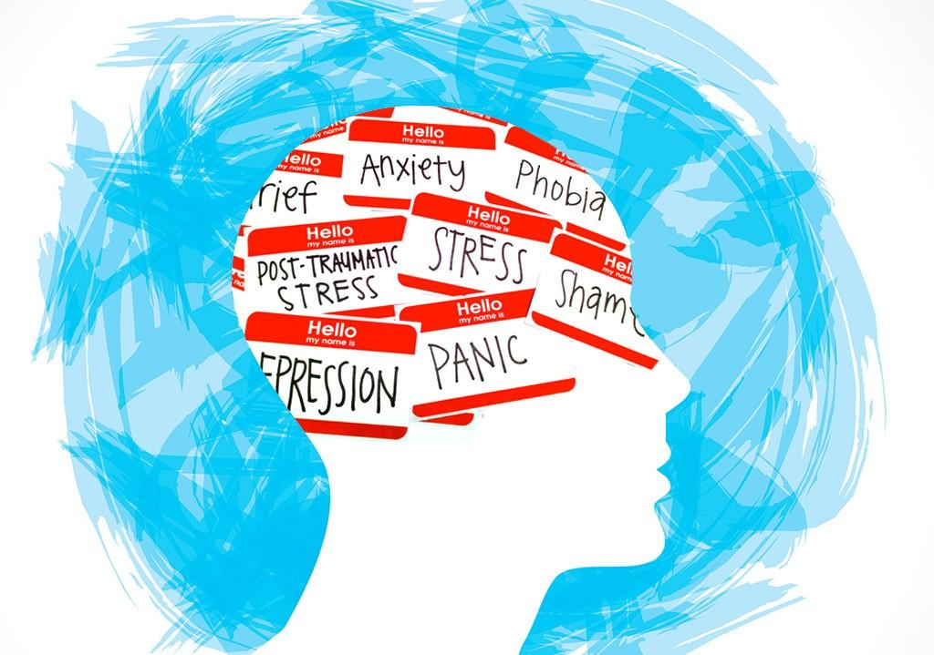
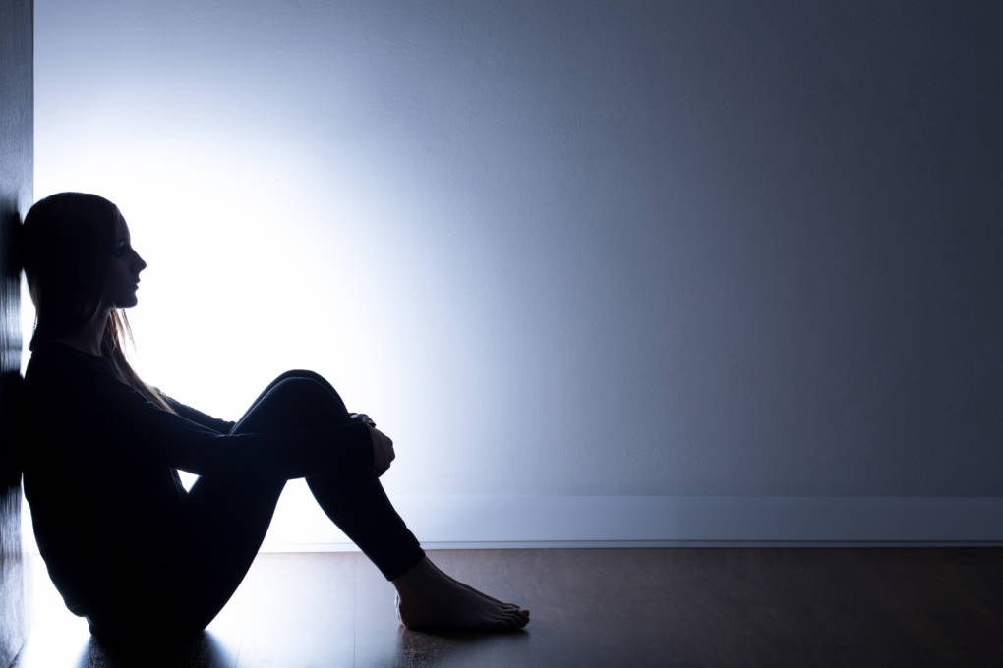
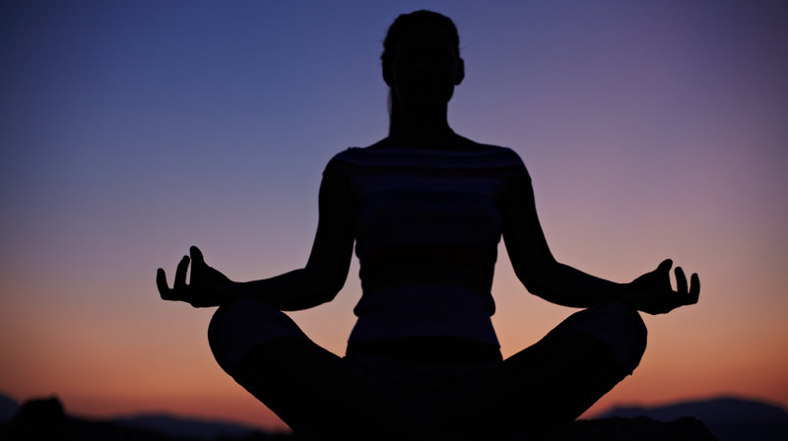
11 Dasindu
During this period of the COVID-19 pandemic, mental health has become a major issue in society. More and more people are experiencing greater levels of anxiety, fear and depression.
The best way to overcome these problems is to practise mindfulness and meditation. In the Karaniya Metta Sutta the Buddha says ‘this is what should be done by one who wants to be peaceful and happy’ and teaches us the qualities that we need to develop to be able to meditate.

Slide 15
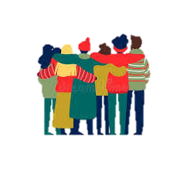
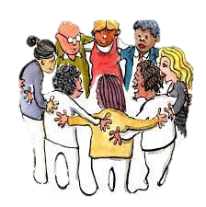
12 Menadee
We should be able, honest, straightforward, easy to advise, humble, not conceited, proud or demanding,
We must learn to be contended and satisfied with what we have and live simply. We should be careful and not wasteful.

Slide 16
13 Rawija
As we develop these qualities we become peaceful and calm and wise and skilful.
We have confidence that by leading virtuous lives we create good karma. So whether it is COVID-19 , natural disasters, crime or war, the chances are we will be safe from harm.
Practising the Buddha’s teachings will keep us free from suffering.

