Slide 1
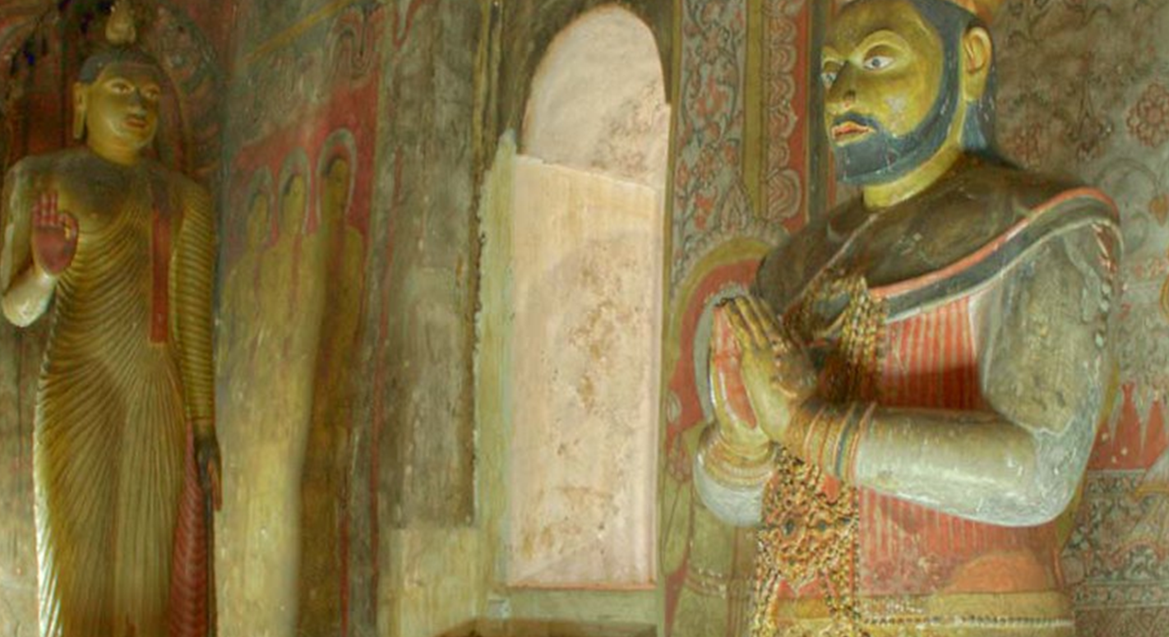
Budu Guna innumerable
“ Story of King Saddhathissa and Kalabuddharakkitha thero”
Reference- Rerukane Chandawimala Thero ( 2017). Suwisi Maha Gunaya. Sri Chandawimala Dharma Pusthaka Sanrakshana Mandalaya.
Level 4 students.

Slide 2
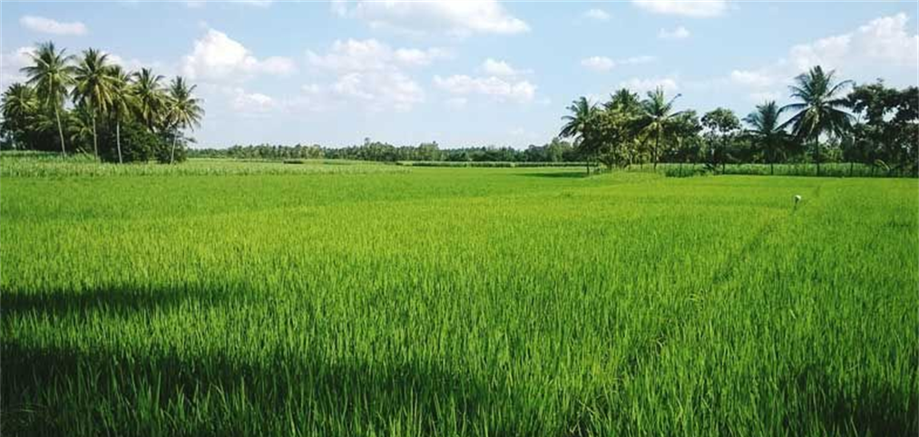
“ Dear king, think of a hundred acres paddy filed, there are too many grains in those acres. I picked only one grain. So I chanted only the capacity of one grain but there are too much capacity of remaining grains”

Slide 3
“If I hold a small needle hole to a big river, the amount of water that goes through the needle hole is very small. That is the amount of Budu guna I chanted last night”

Slide 4
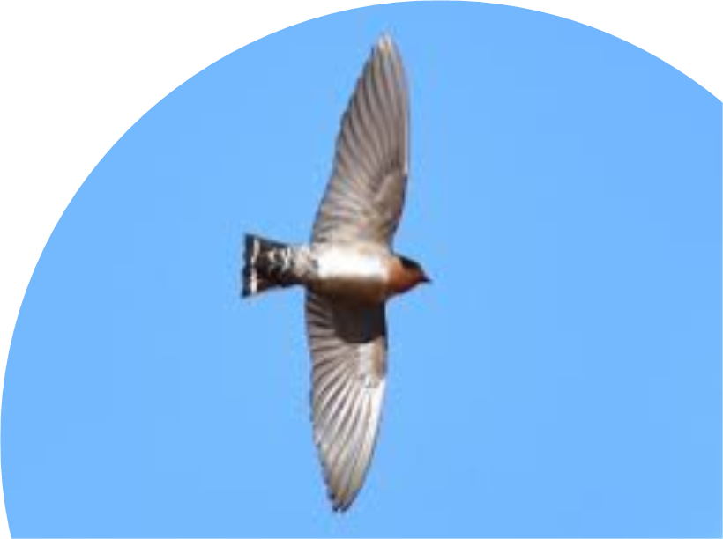
” Dear king, If a Hill swallow is flying through the sky, the amount of sky under the Hill swallow’s space is very small compared to the sky. The amount of Budu guna I chanted last night was that little”

Slide 5
Thank you

