Slide 1
Perth Dhamma School
Level 6
06 December 2020

Slide 2
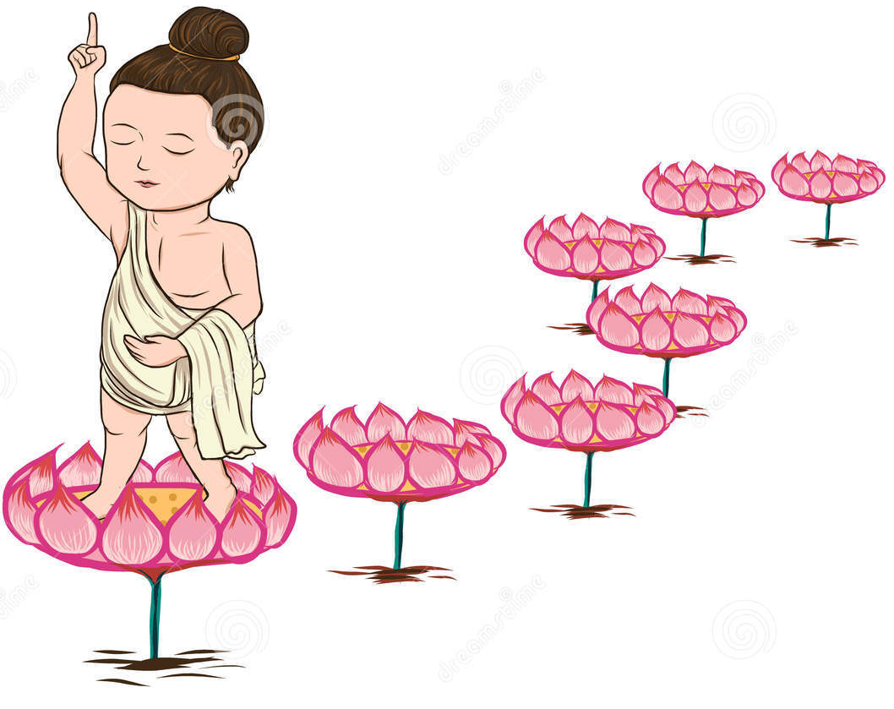
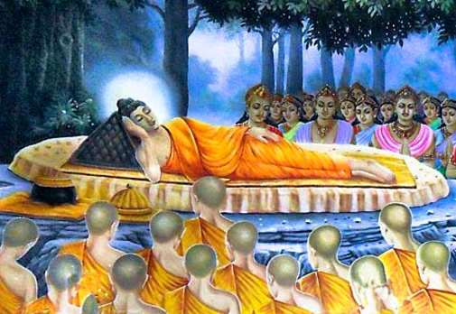
Vesak
Senara

Slide 3
Anuji

Slide 4
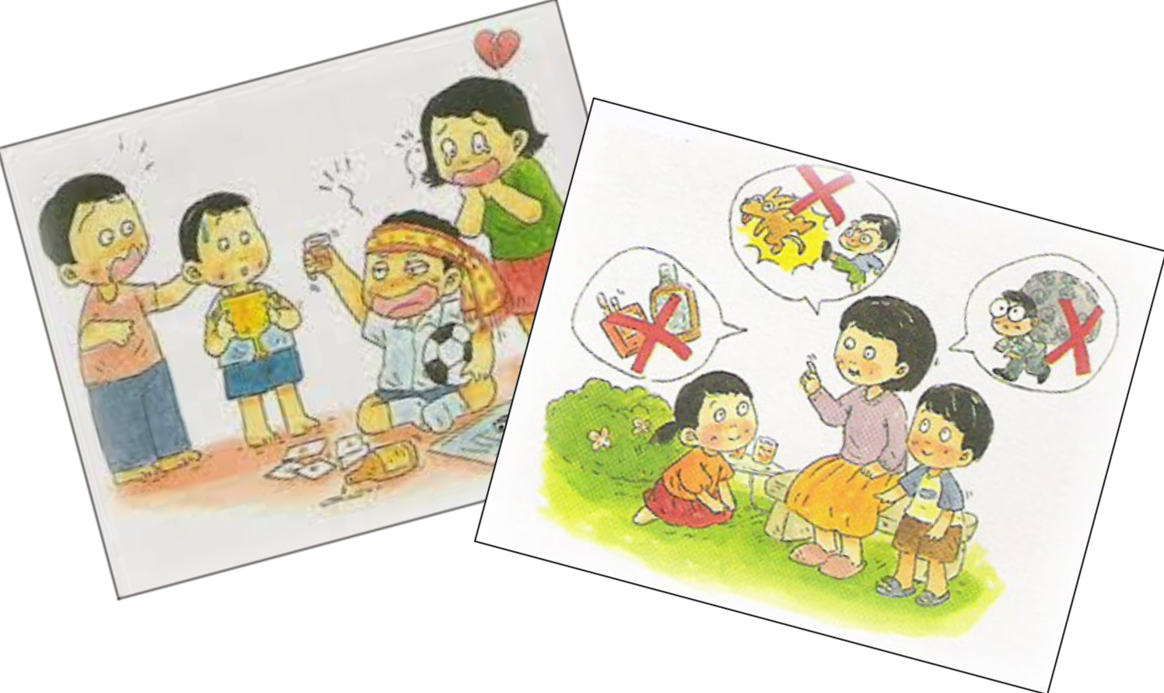
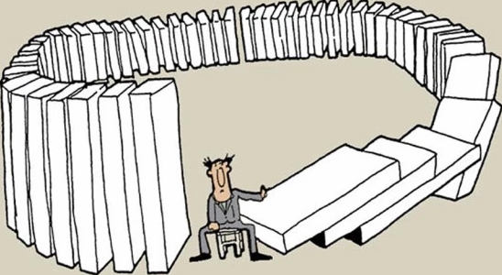
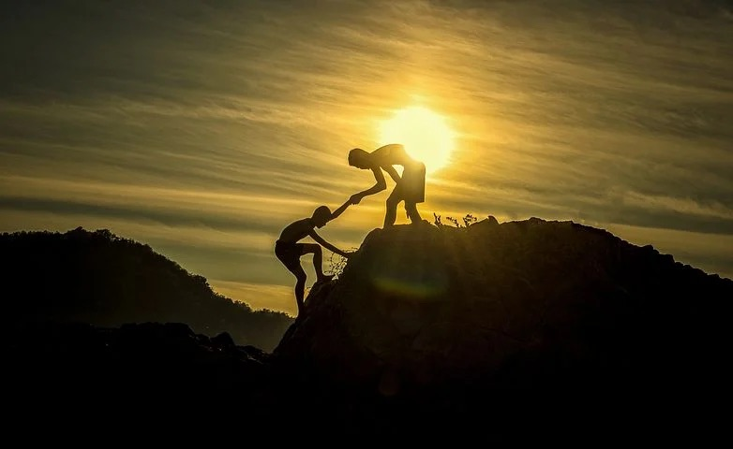
The Five Precepts
The 5 Precepts
Good Karma
Saneja

Slide 5
Saara

Slide 6
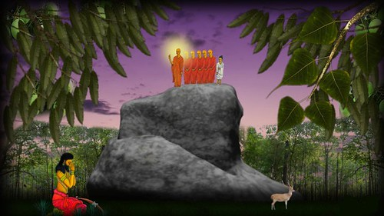
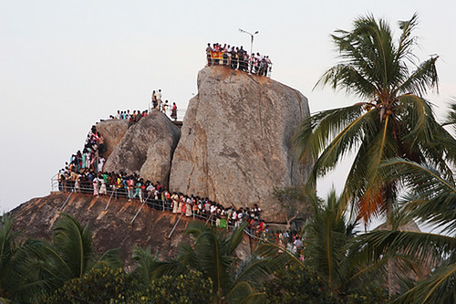
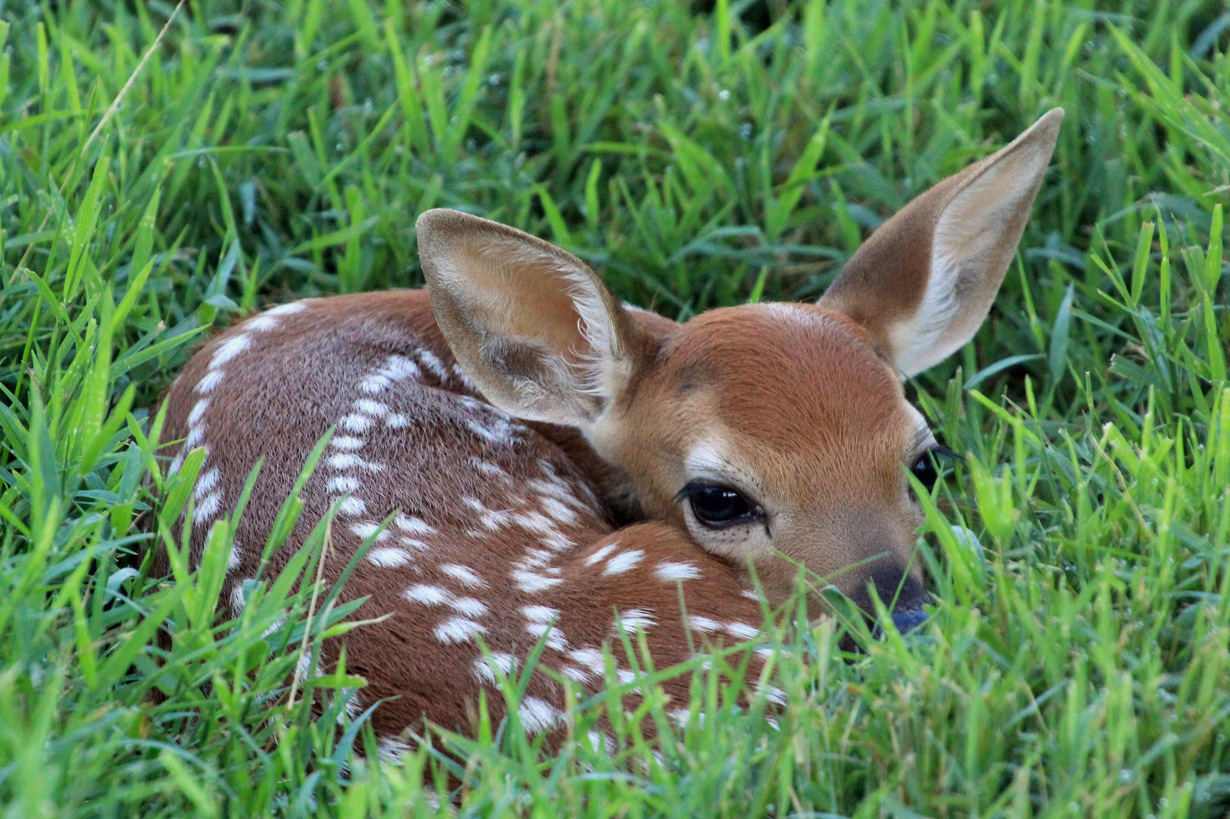
POSON
Nisith

Slide 7
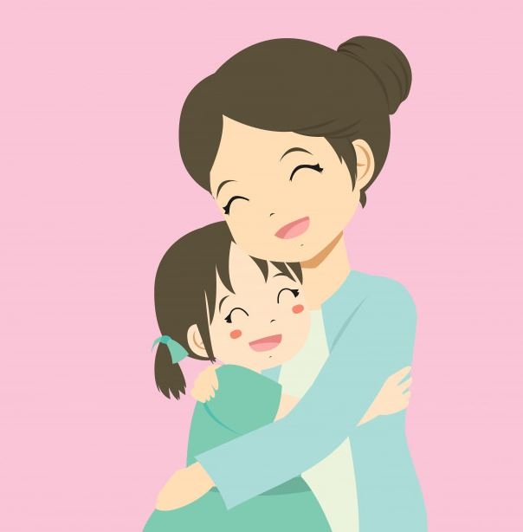
Loving and kindness
Like a mother would protect her only child with her own life,
Let’s spread boundless thoughts of loving kindness towards all beings.
Sandeli

Slide 8
Dasa Akusal (10 unwholesome deeds)
Kaya Akusla
Vaci Akusala
Kaya Akusla
Vaci Akusala
Mano Akusala
If we want to get rid of the tree, we need to remove it from its entire root system. It Is not that easy. But that’s what we have to work for.
Mano Akusala
Sasmi

Slide 9
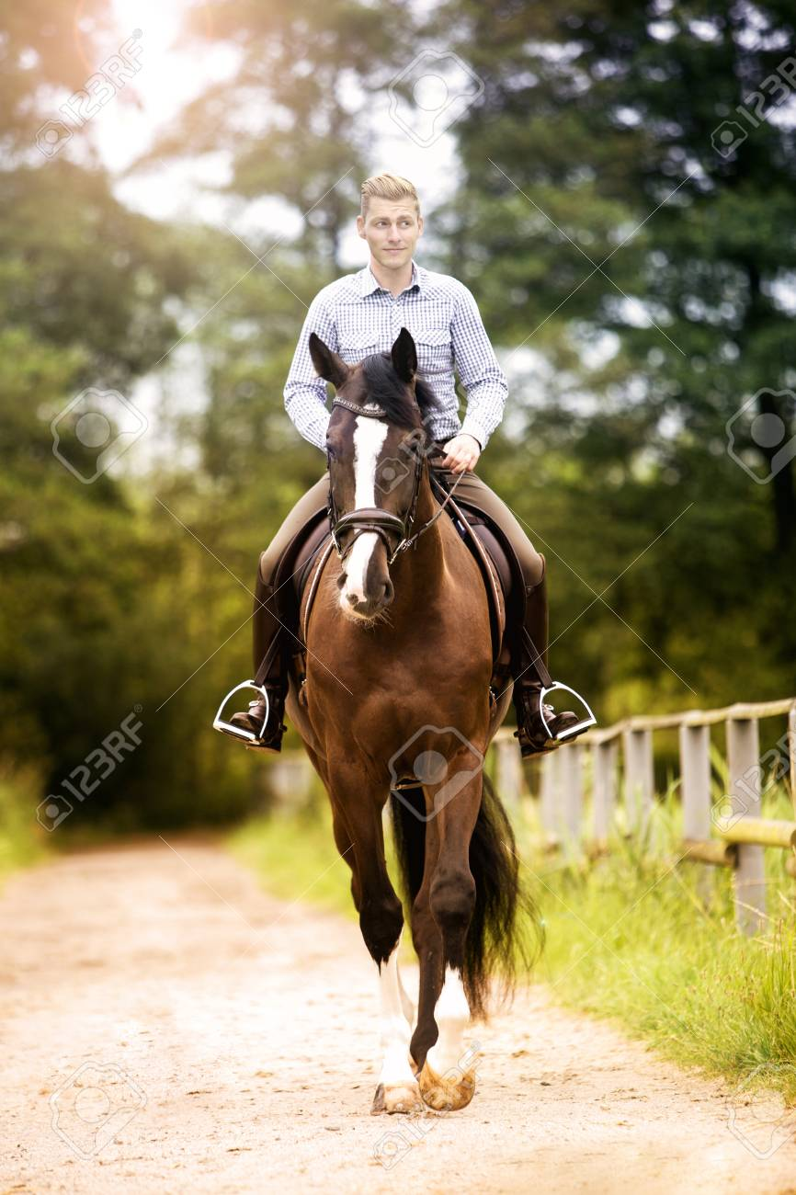
GOOD LUCK , BAD LUCK , WHO KNOWS !

Slide 10
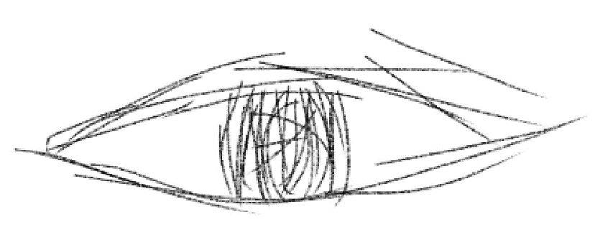
Five senses
Eyes
Nose
Body
Ears
Tongue
Dulkith

Slide 11
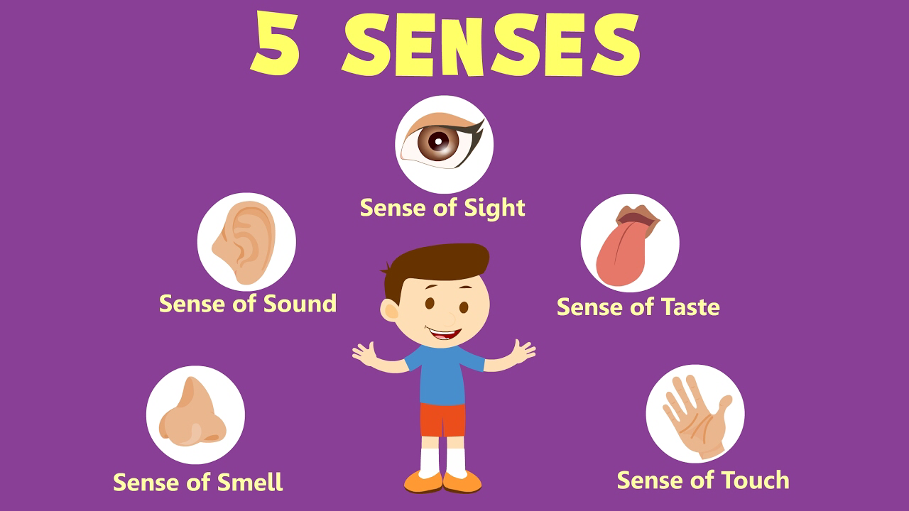
The world is defined by the five senses
Kenul

Slide 12
The 8 Worldly Conditions
HOW TO REFRAIN FROM THE 2 EXTREMES
Januthi

Slide 13
Thank you

